Slide 1
Technical group report
BUSINESS VALUATION
STOCKHOLM SEPTEMBER 2018

Slide 2
Presentation of the technical valuation group
Presentation of the team
Context of the creation of the technical valuation group
Purpose of the group
What has happened so far?
The future plans

Slide 3
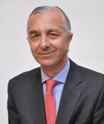
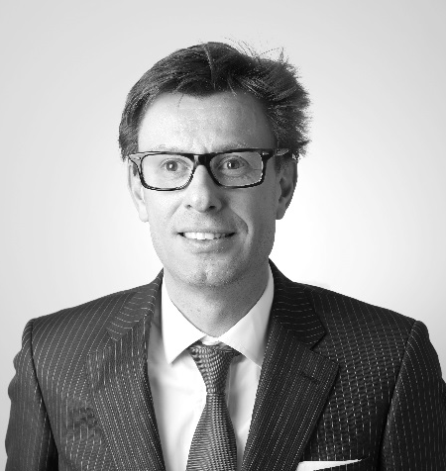
Group Members
LUIS Vilaclara
RONDAERT Frédéric
ALBERTO Carlo Magri
GORMAN David

Slide 4
General environment and context
There has been an increase in our reporting role with regard to Valuation of assets and this is subject to greater regulation and scrutiny by clients and the Authorities.
Tax - BEPS
Accounting law and IFRS
Company law
This may be an opportunity to distinguish CHI network from other networks.
To consider if CHI or some of its members could develop a marketable service to clients
Spread information members and to have an available technical resource.
This is a specialized area and we thought it would be helpful to have a forum to exchange views and discuss issues which arise.
An opportunity to refer work and provide mutual advice.
that valuation skills and specialties exist inside CHI - As a resource to Members

Slide 5
Purposes
Share best practice between members - To compare Valuation methodology
Provide technical support to CHI members
Follow-up valuation actualities and update members accordingly
To identify opportunities in this area for CHI network and individual members
To compile a register of Members providing this service
To create a referable resource available to members carrying out valuation work
Highlighting specialties of the members (real estate, private equity, equipment, intangible assets,…)
Provide support in case of international valuation project

Slide 6
What has happened so far?
Group set-up in June/ July 2018
Valuation committee formed
Two Skype meeting held
Questionnaire circulated to Forum members on their valuation experience
Canvassed members for expressions of interest. To date 7 members have expressed an interest and 4 have participated in Skype meetings
First “Face to face” meeting of Forum in Stockholm prior to welcome dinner.

Slide 7
FUTURE PLANS
Provide services to client of the network
Establish a list of resources available for the network
Improves our skills by creating specialty inside our technical team
To seek advice and guidance from colleagues on approach to valuation work
To have regular Valuation meetings (principally via skype).

Slide 8
Thank you!

